Slide 1
Welcome to Reception
Tintagel Class
Mr Moore (Class Teacher/EYFS Lead)
Restormel Class
Mrs Morris (Class Teacher)

Slide 2
Starting in Reception
Starting Reception is an important part of a child’s education journey, and we aim to make it as fun and positive as possible.
Our transition is planned so that children can build up quickly the time they spend at school and become used to their daily routine.
Children begin Reception on Thursday 4th September and are full-time from then (8:40-3:15)

Slide 3
The school day
The school gate is open from 8.30am. Please bring your child round to their classroom and the door will be open from 8.40 am.
A fruit snack and milk is provided free every day for your child to have for their morning snack (9:45)
All Reception children are eligible for a free school lunch. This can be a hot meal or a sandwich. Every day there is a fantastic salad bar which your child can choose from independently.
If your child would rather have a packed lunch, please send in a healthy lunch in a named lunch box.
All children should bring in a named water bottle. We do encourage the children to drink freely throughout the day.

Slide 4
Your child will be involved in various learning activities throughout the day both inside and outside the classroom.
Please send in a pair of named wellies to keep at school for their outdoor learning when they are likely to get wet and muddy. We do have waterproofs at school which the children can wear.
Also, please send in a change of clothes to be kept at school in case of any accidents.
Please come around to the classroom via the school gate for the end of the day at 3:15.

Slide 5
Starting in Reception
At Pennoweth our Early Years works hard to ensure that your child’s Reception year is happy, active, fun, exciting and secure.
This year your child will continue to follow the EYFS curriculum
This consists of 17 learning areas. There are 3 prime areas and 4 specific areas
Prime Areas: Communication & Language, Physical Development, and Personal Social and Emotional Development
The prime areas help your child to develop skills in the Specific Areas: Literacy, Mathematics, Understanding the World, and Expressive Arts and Design.

Slide 6
School Uniform
Standard Uniform
A black Pennoweth hoodie, sweatshirt or cardigan (with school logo)
Black or dark grey ‘bottoms’ (trousers, shorts or skirts) or pinafore dress. A blue and white checked summer dress can be worn.
Black plain trainers or school shoes
Plain white polo shirt
Grey, black or white socks or black or grey tights
PE / Sports uniform (only to be worn on PE day)
Pennoweth black hoodie
Plain grey or black joggers / leggings or sports shorts
White Polo shirt or in tribal colours (Tribes will be confirmed in September)
In Early Years we encourage the children to be independent so please send your child in with shoes they can put on and take off themselves. Velcro is brilliant!

Slide 7
Pennoweth DNA
We are safe.
We feel loved.
We take responsibility.
We are always learning.
We are ready.

Slide 8

Read, Write, Inc.
Read, Write, Inc is the phonics programme that we use at Pennoweth. It begins discreetly in Nursery and continues until Year 3.
It teaches children to read accurately, fluently with good comprehension.
Daily session 9:00-9:45
https://www.ruthmiskin.com/en/find-out-more/parents/

Slide 9
What is Phonics?
Read Write Inc. Phonics teaches children to read accurately and fluently with good comprehension.
They learn to form each letter, spell correctly, and compose their ideas step-by-step.

Slide 10
Learning Sounds
Single sounds = phonemes e.g. c, m, a
Digraphs: ay (may I play)
ee (what can you see)
Trigraphs: ear, ire, ure, air, igh
Split Digraphs i-e, e-e, a-e o-e
Special friends ff, ss ll, ck, ng, ch, sh,
Notes:
A digraph is a combination of two letters representing one sound, as in ph and ey.
A trigraph is a single sound that is represented by three letters,
Split digraph is where a digraph has been split by a consonant

Slide 11
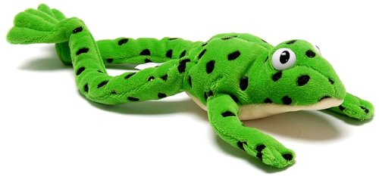
Fred Talk
Special Friends
Fred Talk
Read the Word
Segmenting e.g. sh-o-p ch-a-t g-oa-t
Blending putting the word together

Slide 12
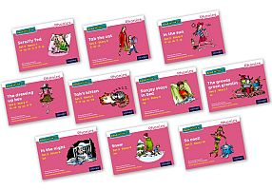
RWI lessons
All lessons cover sounds, green words (real words) linked to the new sound or sounds, Red Words (words that cannot be sounded out), Alien words and a Ditty book or a story book.
Ditty and story books are differentiated to meet the different abilities.

Slide 13

- Tapestry is an online learning journal where children’s work and progress is recorded.
- Also acts as a home-school learning tool.
- Allows us to share photos and learning.
- Parents will be given passwords so they can log on in September.

Slide 14


Big Brush Club
Big Brush Club is here to help prevent decay by encouraging children to brush their teeth twice a day, forming positive lifetime habits that will make a difference.
Daily application of fluoride toothpaste to teeth reduces the incidence and severity of tooth decay in children. For example, moving from brushing once a day to twice a day lowers an individual’s risk of developing dental caries by 14%.
Brushing takes place after lunch play. Children are provided with their own individually labelled toothbrush.
Dry brushing takes place (2 minutes). Children are provided with non-foaming toothpaste and shown how to brush.
Toothbrushes are washed after brushing and stored in a hygienic box.

Slide 15
Contacts
pennowetheyfs@croftymat.org
help@pennoweth.cornwall.sch.uk
01209 215671

